Slide 1
CS2106 Tutorial 9
Virtual memory management

Slide 2
Q1
Paging and Virtual memory

Slide 3
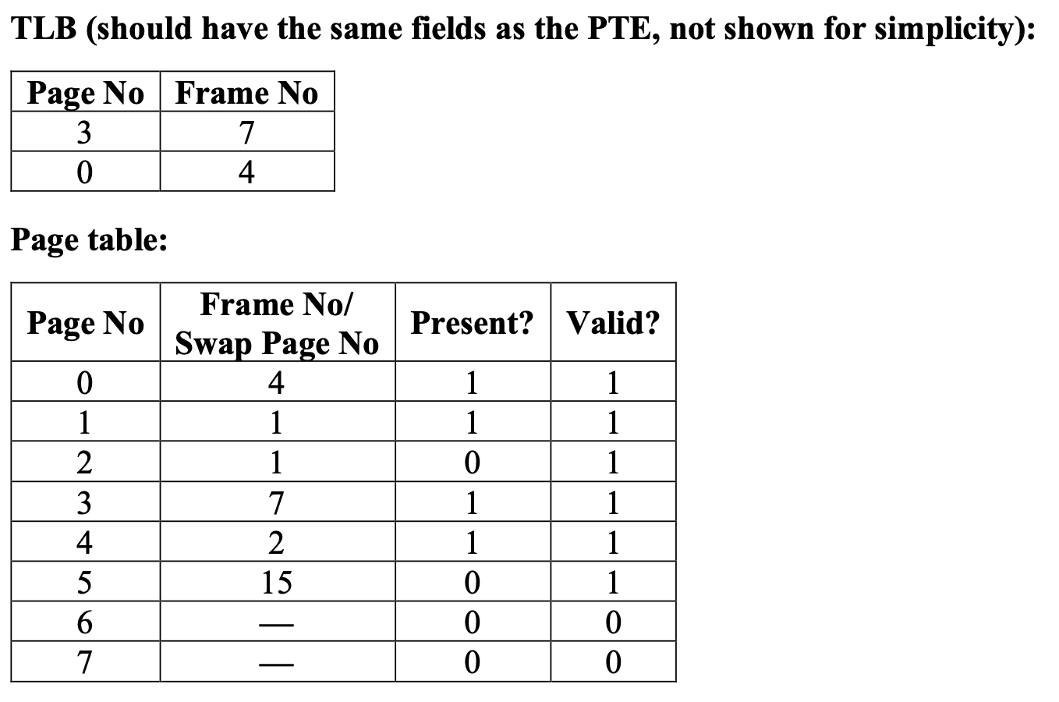

Q1
Page Size = Frame Size = 4KB
TLB = 2 entries (0.1)
Page Table = 8 entries (i.e. 8 pages, 0..7)
Physical Frame = 8 frames (0..7)
Swap Page (Virtual page in hard disk) = 16 pages (0..15)

Slide 4
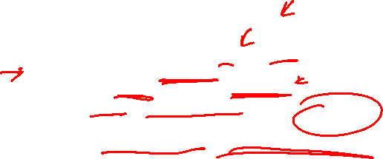
Q1a: OS page fault handler
Algorithm for accessing virtual address VA:
1. [HW] VA is decomposed into <Page#, Offset>
2. [HW] Search TLB for <Page#>:
a. If TLB miss: Check the page table
3. [HW] Is <Page#> memory resident?
a. Non-memory resident: Trap to OS { Page Fault }
4. [HW] Use <Frame#><Offset> to access physical memory.

Slide 5
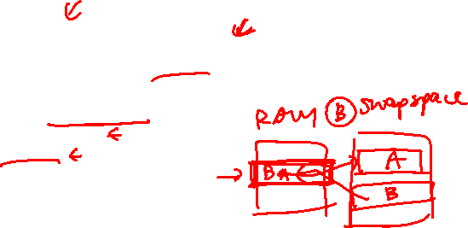
Q1a: OS page fault handler
Algorithm for Page Fault Handler, given <Page #>:
1. [OS] Global/Local replacement, Replacement algorithm applicable here
2. [OS] Write out the page to be replaced if needed.
3. [OS] Locate the page in secondary swap pages.
4. [OS] Load the page into a physical frame.
5. [OS] Update page table entries.
6. [OS] Flush TLB if needed.
7. [OS] Return from Trap
in this question, it picks the entry with the smallest page no

Slide 6
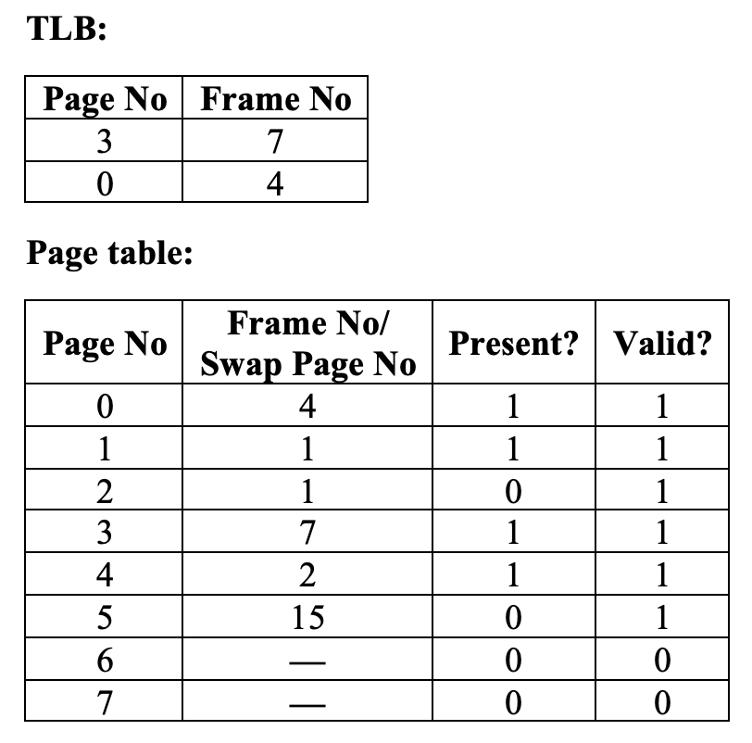
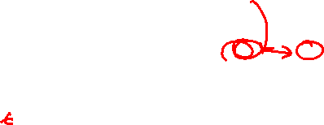
Q1b (i): access page 3
Algorithm for accessing virtual address VA:
1. [HW] VA is decomposed into <Page#, Offset>
2. [HW] Search TLB for <Page#>:
a. If TLB miss: Check the page table
3. [HW] Is <Page#> memory resident?
a. Non-memory resident: Trap to OS { Page Fault }
4. [HW] Use <Frame#><Offset> to access physical memory.

Slide 7
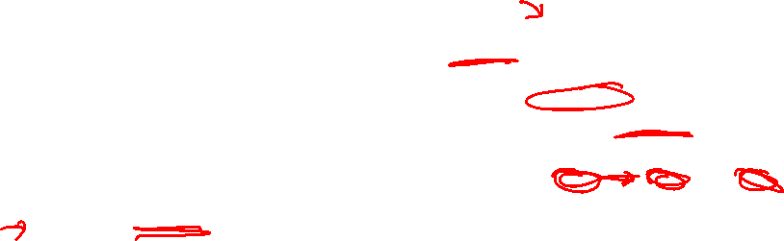
Q1b (ii): access page 1
Algorithm for accessing virtual address VA:
1. [HW] VA is decomposed into <Page#, Offset>
2. [HW] Search TLB for <Page#>:
a. If TLB miss: Check the page table
3. [HW] Is <Page#> memory resident?
a. Non-memory resident: Trap to OS { Page Fault }
4. [HW] Use <Frame#><Offset> to access physical memory.
TLB will be updated to contain this PTE

Slide 8
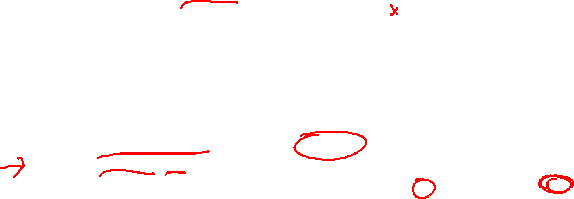
Q1b (iii): access page 5
Algorithm for accessing virtual address VA:
1. [HW] VA is decomposed into <Page#, Offset>
2. [HW] Search TLB for <Page#>:
a. If TLB miss: Check the page table
3. [HW] Is <Page#> memory resident?
a. Non-memory resident: Trap to OS { Page Fault }
4. [HW] Use <Frame#><Offset> to access physical memory.

Slide 9
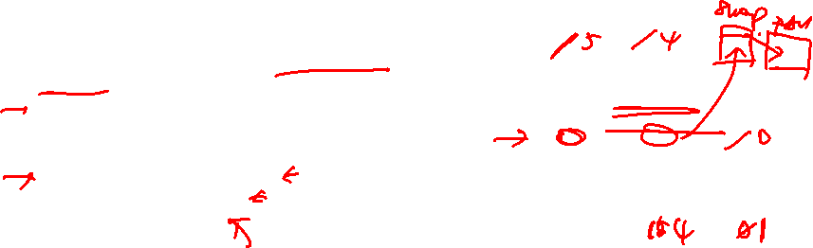
Q1b (iii): access page 5
Algorithm for Page Fault Handler, given <Page #>:
1. [OS] Global/Local replacement, Replacement algorithm applicable here
2. [OS] Write out the page to be replaced if needed.
3. [OS] Locate the page in secondary swap pages.
4. [OS] Load the page into a physical frame.
5. [OS] Update page table entries.
6. [OS] Flush TLB if needed.
7. [OS] Return from Trap

Slide 10
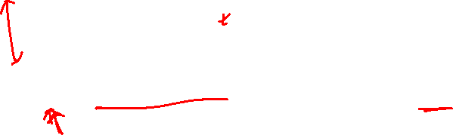
Q1c: best and worst memory access scenarios
TLB access time = 1ns
Memory access time = 30ns
Hard disk access time (per page) = 5ms
how to calculate?
overhead + actual memory access ← actual memory access is always 30ns

Slide 11

Q1c: best and worst memory access scenarios
TLB access time = 1ns
Memory access time = 30ns
Hard disk access time (per page) = 5ms
how to calculate?
overhead + actual memory access ← actual memory access is always 30ns
best scenario overhead
= TLB-Hit
= 1ns
total = 31ns

Slide 12
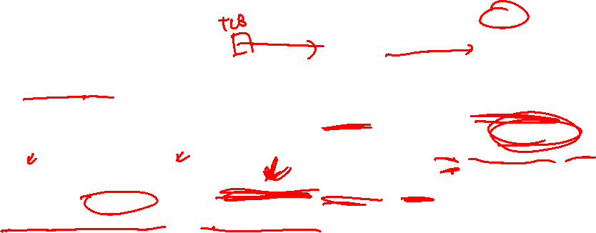
Q1c: best and worst memory access scenarios
TLB access time = 1ns
Memory access time = 30ns
Hard disk access time (per page) = 5ms
how to calculate?
overhead + actual memory access ← actual memory access is always 30ns
Minimal overhead in worst scenario:
= TLB access (miss) + full table access + service page fault (Write out and Write in)
= 1ns + 30ns + 5ms + 5ms
= 10,000,031ns (10.000,031ms)
5ms to evict existing page from RAM +
5ms to store new page in RAM
the solution ignores the overhead of re-accessing TLB and/or page table. So, it should be taken as the minimal overhead.

Slide 13

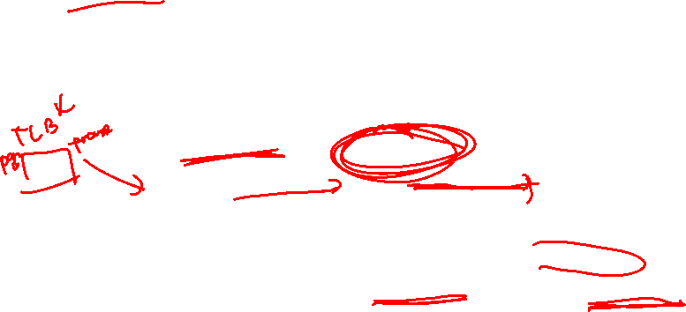
Q1d: worst case with 2 level paging
2 level paging == the smaller page tables are stored in separate pages.
When 2 level paging is used, there exists an even worse scenario:
a particular smaller page table is needed, it may not be in physical memory
page fault occurs when retrieving lower level page smaller page table
Hence, there is a possibility of servicing two page faults under the 2-level paging scheme.

Slide 14
Q2
Page table structure

Slide 15
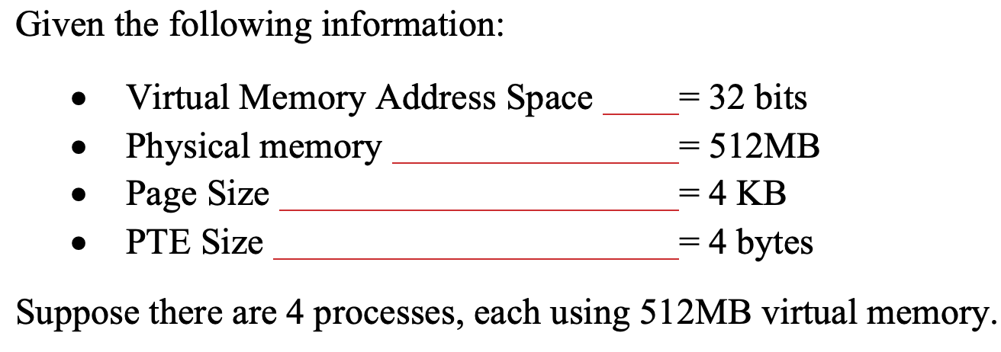

Q2a
= 2⁹ * 2²⁰
= 2² * 2¹⁰
Direct paging is used. What is the total space needed for all page tables used?

Slide 16
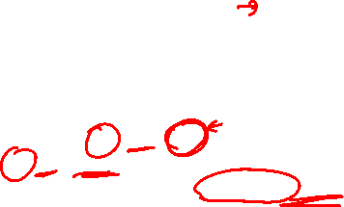
Q2a
= 2⁹ * 2²⁰
= 2² * 2¹⁰
Direct paging is used. What is the total space needed for all page tables used?
Number of page table entries = 2³² / 2¹² = 2²⁰
Size of page table = 2²⁰ * 4 = 4 MB
Each process has its own page table, so total is 4 MB * 4 = 16 MB

Slide 17
Q2b
= 2⁹ * 2²⁰
= 2² * 2¹⁰
2-level paging is used. What is the total space needed for all page tables used?

Slide 18
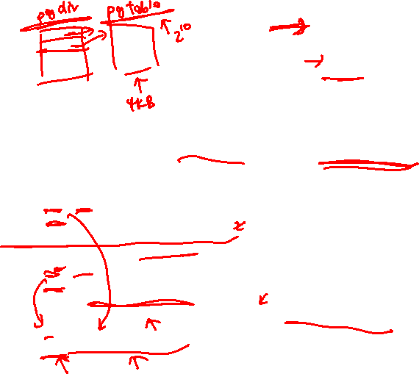
Q2b
= 2⁹ * 2²⁰
= 2² * 2¹⁰
2-level paging is used. What is the total space needed for all page tables used?
The page table will be split into smaller page tables, each fitting into a page.
Number of PTE per smaller page table
= Page Size / PTE size
= 2¹² / 2²
= 2¹⁰ entries per smaller page table
Total Number of page table entries (PTE)
= Total Memory / Page Size
= 2³² / 2¹²
= 2²⁰ page table entries
Total number of smaller page tables
= Total number of PTE / Number of PTE per smaller page table
= 2²⁰ / 2¹⁰
= 2¹⁰ smaller page tables

Slide 19
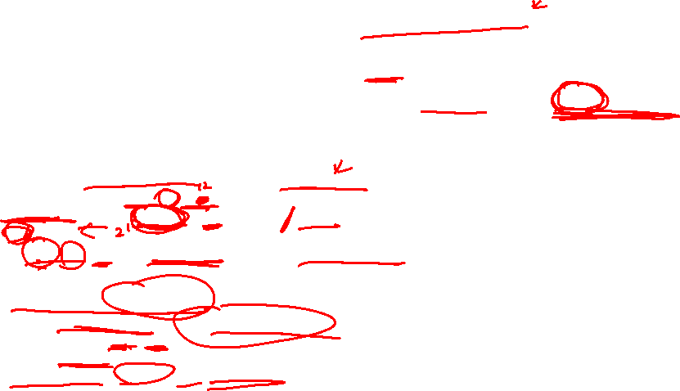
Q2b
= 2⁹ * 2²⁰
= 2² * 2¹⁰
2-level paging is used. What is the total space needed for all page tables used?
Assuming the same size of entry is used in page directory, then a page directory is 2¹⁰ * 4 = 212 (4 KB) in size.
A process uses only 512 MB = 2²⁹ (512 MB) / 2¹² (4 KB) = 2¹⁷ pages.
So 2¹⁷ / 2¹⁰ = 2⁷ = 128 page table portions (smaller page table) are used
Overhead for a single process
= 1 page directory + 128 page table portions
= 4 KB + 128 * 4 KB
= 516 KB
Total overhead = 516 KB * 4 = 2064 KB

Slide 20
Q2c
= 2⁹ * 2²⁰
= 2² * 2¹⁰
Inverted table is used. What is the total space needed? You can assume each inverted table entry takes 8 bytes.

Slide 21
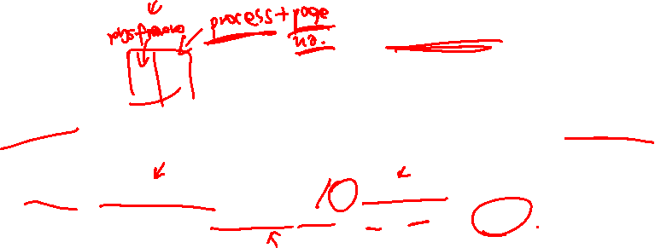
Q2c
= 2⁹ * 2²⁰
= 2² * 2¹⁰
Inverted table is used. What is the total space needed? You can assume each inverted table entry takes 8 bytes.
Number of physical frames is = 2²⁹ (512 MB) / 2¹² = 2¹⁷ frames
A single frame table is used system wide, overhead = 2¹⁷ * 8 B = 2²⁰ = 1 MB

Slide 22
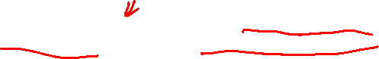
Q2c
= 2⁹ * 2²⁰
= 2² * 2¹⁰
Inverted table is used. What is the total space needed? You can assume each inverted table entry takes 8 bytes.
Number of physical frames is = 2²⁹ (512 MB) / 2¹² = 2¹⁷ frames
A single frame table is used system wide, overhead = 2¹⁷ * 8 B = 2²⁰ = 1 MB
Q: Why do you think the inverted table entry takes up more space than a page table entry?
A: The IPT entry needs to record the PID in addition to the logical/virtual address (as two processes could have different physical pages mapped to the same logical/virtual address).

Slide 23
Q3
Page replacement

Slide 24
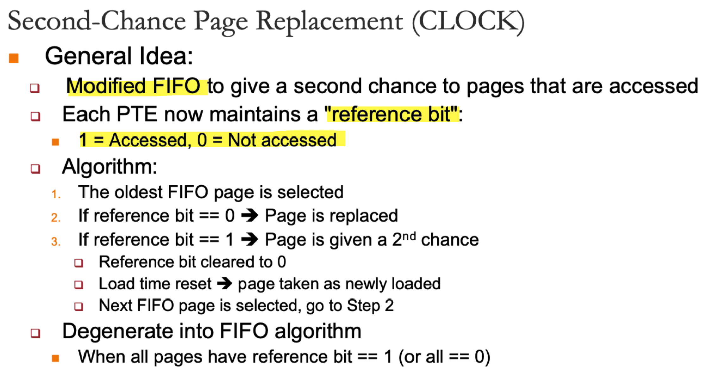
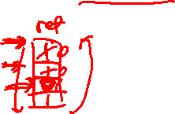
Recap on CLOCK

Slide 25
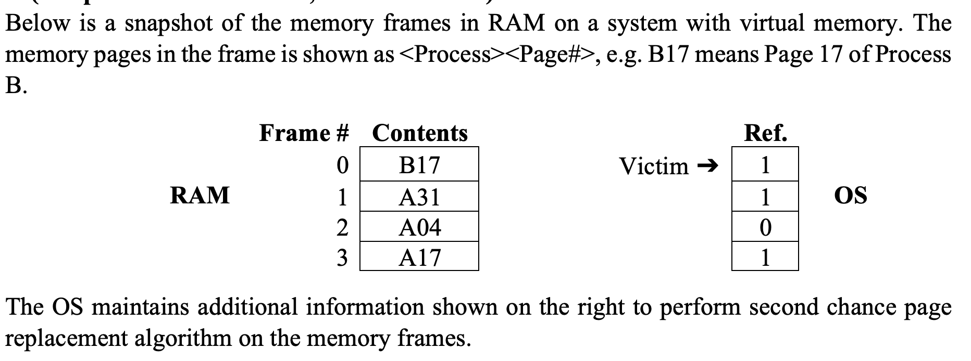
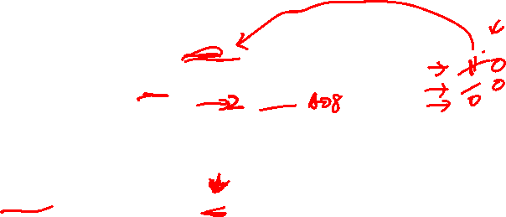
Q3a
Suppose process A accesses page 8 (i.e. A08) now.
Which memory frame will be replaced?

Slide 26
Q3a
Suppose process A accesses page 8 (i.e. A08) now.
Which memory frame will be replaced?

Slide 27
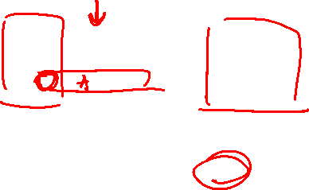
Q3b
Give the steps the OS takes to update the affected page table entries (without an inverted page table).

Slide 28
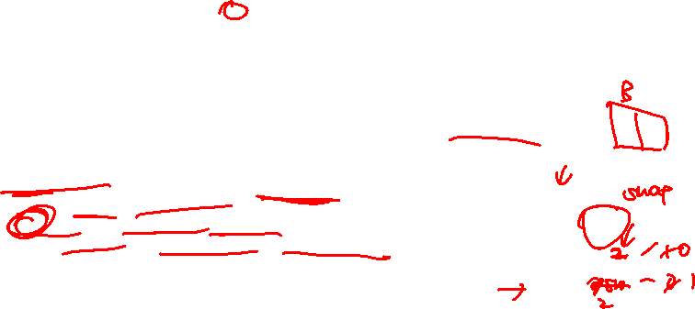
Q3b
Give the steps the OS takes to update the affected page table entries (without an inverted page table).
Steps taken:
Identify the process that owns the page in frame 2
Since there is NO inverted page table
Scan through every process’s page table
Find the page that is memory resident and located in frame 2
Mark Process A’s page 4 as not memory resident
Mark Process B’s page 8 as memory resident
Page table of A
page no | frame no | present
04 | - | 0
08 | 2 | 1

Slide 29

Q3c
Continuing from (a), suppose process B accesses page 13 (i.e. B13) now.
Which memory frame will be replaced?

Slide 30

Q3c
Continuing from (a), suppose process B accesses page 13 (i.e. B13) now.
Which memory frame will be replaced?
Page table of B
page no | frame no | present
17 | - | 0
13 | 0 | 1

Slide 31

Q3d
If the OS keeps an inverted page table, give the contents of the inverted page table after the replacements (after (a) and (c)).

Slide 32
Q3e
Give the steps the OS takes to update the affected page table entries with the help of the inverted page table.

Slide 33
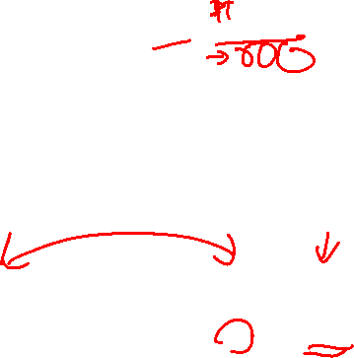
Q3e
Give the steps the OS takes to update the affected page table entries with the help of the inverted page table.
Page table of A
Page table of B
page no | frame no | present
04 | - | 0
08 | 2 | 1
page no | frame no | present
17 | - | 0
13 | 0 | 1

Slide 34
Q4
Applications of virtual memory

Slide 35
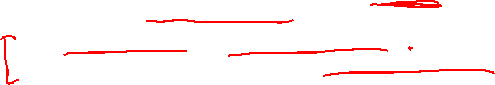
Q4a
An application of virtual memory in some OSes (including Linux) is overcommit. When overcommit is enabled, the OS will not allocate pages immediately upon request, but instead only when they are actually used.
In Linux, a new memory allocation has its contents initialised to zero. Overcommit allows Linux to defer allocating pages for a memory allocation until the program writes to the memory, (if it ever does).
How can this be implemented, while allowing reads to be successful?

Slide 36
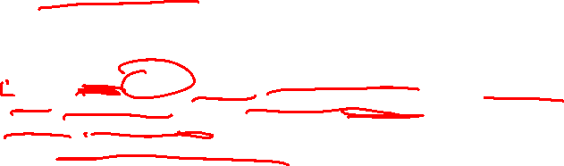
Q4a
An application of virtual memory in some OSes (including Linux) is overcommit. When overcommit is enabled, the OS will not allocate pages immediately upon request, but instead only when they are actually used.
In Linux, a new memory allocation has its contents initialised to zero. Overcommit allows Linux to defer allocating pages for a memory allocation until the program writes to the memory, (if it ever does).
How can this be implemented, while allowing reads to be successful?
Allocate a single read-only “zero page” that is filled with zeroes. When a program requests for memory, map the new pages to the zero page as a read-only mapping. If the program writes to memory, a segmentation fault/general protection fault will be triggered; at this point, we have to actually allocate a page to the program.

Slide 37

Q4b
Another application of virtual memory is demand paging, which ties in closely with the idea of memory-mapped files (i.e. mmap). Memory-mapped files are a natural extension to the idea of a swap file; in a way, we are simply allowing programs to specify the “backing store” for a particular region of memory.
How can demand-paged (i.e. the file is not read until the program actually reads from the mapped region) memory-mapped files be implemented?

Slide 38
Q4b
Another application of virtual memory is demand paging, which ties in closely with the idea of memory-mapped files (i.e. mmap). Memory-mapped files are a natural extension to the idea of a swap file; in a way, we are simply allowing programs to specify the “backing store” for a particular region of memory.
How can demand-paged (i.e. the file is not read until the program actually reads from the mapped region) memory-mapped files be implemented?
When a program maps a file, simply record the memory region as mapped to the given file, and insert the relevant page table entries as non-resident pages. (Some other tracking structures will likely be needed.) When the program tries to read from the region, a page fault will occur, and the OS can then perform the file read for the page at that point.

Slide 39
Q4c
Another application of virtual memory is demand paging, which ties in closely with the idea of memory-mapped files (i.e. mmap). Memory-mapped files are a natural extension to the idea of a swap file; in a way, we are simply allowing programs to specify the “backing store” for a particular region of memory.
What are the advantages and disadvantages of using memory-mapped files compared to regular read/write system calls?

Slide 40
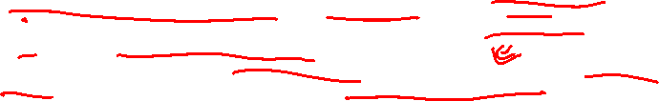
Q4c
Another application of virtual memory is demand paging, which ties in closely with the idea of memory-mapped files (i.e. mmap). Memory-mapped files are a natural extension to the idea of a swap file; in a way, we are simply allowing programs to specify the “backing store” for a particular region of memory.
Advantages:
(For the programmer) The programmer can simply read/write from memory and not have to deal with read/write syscalls.
(For the OS) The OS can easily reclaim those pages in physical memory by simply reusing the pages (if it knows that the pages have not been modified), or by writing the changes back to the file (which can be done even if there is no swap file configured on the system), since it can simply read the pages from the file again if a program reads from the mapped region of memory.
(For the OS/system as a whole) With read/write syscalls, the data is read into memory that is private to the program. If multiple processes read from the same file, the data is duplicated in memory. With memory-mapped files, the OS can simply share the same physical pages across multiple processes, saving physical memory.

Slide 41
Q4c
Another application of virtual memory is demand paging, which ties in closely with the idea of memory-mapped files (i.e. mmap). Memory-mapped files are a natural extension to the idea of a swap file; in a way, we are simply allowing programs to specify the “backing store” for a particular region of memory.
Disadvantages:
It is generally not possible to return an error from a memory read. If there is an error when reading the mapped file to fulfil a memory read, the program gets a SIGSEGV or SIGBUS, which is much harder to recover from than a failed syscall.
It is also not possible to fulfil memory reads asynchronously. Thus if the file read takes a while, the program will be blocked until the read completes (or fails). (This can be slightly mitigated with the madvise syscall.)

Slide 42
Optional Q5
page table structure

Slide 43
Q5
A computer system has a 36-bit virtual address space with a page size of 8 KB, and 4 bytes per page table entry.
How many pages are there in the virtual address space?
A 36-bit virtual address can address 2³⁶ bytes in a byte addressable machine. Since the size of a page is 8 KB (2¹³), the number of addressable pages is 2³⁶ / 2¹³ = 2²³.
What is the maximum size of addressable physical memory in this system?
Assuming that all 4 bytes in each PTE is used for the frame address, then we can address 2³² physical frames. Since each frame is 2¹³ bytes long, the maximum addressable physical memory size is 2³² * 2¹³ = 2⁴⁵ bytes (32 TB).

Slide 44
Q5
A computer system has a 36-bit virtual address space with a page size of 8 KB, and 4 bytes per page table entry.
If the average process size is 8 GB, would you use a one-level or two-level page table? Why?
8 GB = 233 bytes. We need to analyse the memory and time requirements of the two paging schemes in order to make a decision. The average process size is considered in the calculations below.
1-level paging: Since we have 2²³ pages in each virtual address space, and we use 4 bytes per page table entry, the size of the page table will be 2²³ * 2² = 2²⁵ (32 MB). This is 1 / 256 of the process's own memory space, so it is quite costly.
2-level paging: The single page table will be broken into multiple page tables, and each can fit into a single page. Since we have 8 KB (2¹³ B) pages and 4-byte PTEs, each small table can hold 2¹¹ PTEs. There is a total of 2²³ / 2¹¹ = 2¹² page tables ➔ the page directory has 2¹² entries. Hence, the virtual address would be divided up as 12 | 11 | 13.
Since the process' size is only 8 GB (2³³) ➔ only 2³³ / 2¹³ = 2²⁰ pages. So we only need 2²⁰ / 2¹¹ = 2⁹ page tables (instead of the full range of 2¹²).
The total overhead is then (size of page directory) + (total size of page tables) = (2¹² * 4) + (2⁹ * 2¹¹ * 4) = 4112 KB.
As seen, 2-level paging requires much less space than level 1-paging scheme.

Slide 45
Thank you!

